Slide 1
PGR-In defense of meta-analysis

Slide 2
Claim
I’d argue that for most problems in pulmonary critical care, the best source of evidence is the best meta-analysis, not the best individual trial.
The way trials are currently funded leads to them being systematically underpowered and not fit to answer the relevant question.
GIGO is a problem, but it’s less of one than you might think
Notes:
Usual critique of meta-analysis goes:
Look at the critique of this included trial… flawed!
Garbage in, garbage out
Thus, this MA is not the best evidence on the subject, instead this more rigorous single trial should inform our opinion.

Slide 3
How big of a problem is under-powering?
How, in practice, trials are powered
  Reference under powering our cities as a threat to using them as the only acceptable sort of knowledge. Or more precisely saying our cities have not shown in affect therefore, there is none. Because I see Peter systematically under powered to find important effects I’ll give a defensive met and I’ll see you in the talk next time
  ‘Minimum Important Difference Is Minimally Important in Sample Size Calculations | Trials | Full Text -> the best guess should be the delta
  We are OFF in how we estimate this (scott’s article, CHEST underpowered) – this might be because people powering trials are incentivized to be off (for someone to let them run the trial), or because we really are just bad at it… thus trials are systematically under-powered
  If 0.8 * several trials is likely to give conflicting results… 0.7 or 0.6 etc. is WAY likely to give conflicting results (thus, you need to combine)
Power? This is a bigger problem than recognized. Which do you trust, a meta-analysis, or an underpowered trial. What do you trust for subgroups and heterogeneity… can almost never make conclusions from a signle trial

Slide 4
Is there actually a replicability crisis?
It is incorrect to view some studies being “positive” and some studies being “negative” as conflicting

Slide 5
GIGO: vs wisdom of crowds? What is the likelihood that all the studies are off in the same way?

Slide 6
Myth: you can’t make good estimates from junk evidence

Slide 7
Point:
Myth: Garbage-in-garbage-out is why meta-analyses are
The goal of a meta-analysis is to make a claim precisely as strong as the evidence
https://twitter.com/dnunan79/status/1620366744971014145?s=12&t=u13LZ0WKG90XsOBRpngPrA

Slide 8
Poorly done meta-analysis; over- or –nder-stating the evidence
Difference between systematic review and meta-analysis - the way you meta-analyze is the point of contention.
Note: this isn’t arguing that quality of the studies doesn’t matter - it clearly does matter. It’s arguing that even flawed studies provide some information and shouldn’t be ignored altogether - not binary.
Note: GRADE framework -
Design of primary studies
Quality of primary studies (risk of bias)
Inconsistency
Indirectness
Imprecision
Others (publication bias, large effect, dose-response gradient, plausible confounding?)

Slide 9
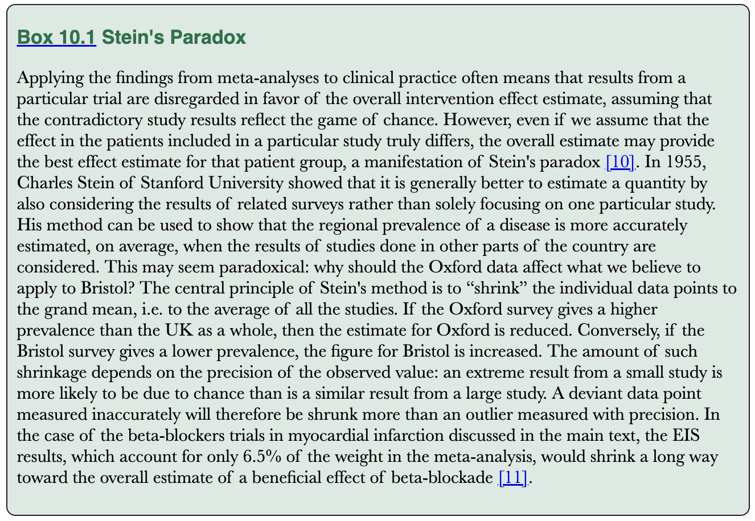
Outside view vs Inside view
From: https://onlinelibrary.wiley.com/doi/10.1002/9781119099369.ch10
Experts are often overly drawn to the inside view
Outside view can be given by mata-analyses and improves

Slide 10
Scout mindset vs soldier mindset:
Can I believe this? Vs Must I believe this?
—> we can find flaws in the studies, but how certain are we that those flaws ARE WHY the trial result is what it is.
Problem: does the flaw explain the deviation? Would you equally point out the same flaw in a different study with the opposite answer?
— how large is the noise/chance associated with the most rigorous study?
— what extent are there concerns about generalizability?
—— if generalizability is a concern, isn’t various settings a benefit?
— shouldn’t use still systematically synthesize all the data, just weighted appropriately for it’s methodology flaws?

Slide 11
If RCTs are a test: it may give you a yes/no to a hypothesis to a certain error rate—— but it does not give you an accurate point estimate.
Go through the Ioannidis argument: why should you question even a great study? Likelihood of passing a single test.

Slide 12
Trial sequential analysis -> when should we have stopped objecting

Slide 13
Problems with subgroups / effect modifiers
A single huge trial could be the best convincing answer, but you’re still left with uncertainty about applicability (maybe – though I think this is over-rated: effect modifiers are rarer than we think)

Slide 14
Final argument: epistemic
Numerical justification that your prediction of future studies are better.

